Slide 1
Topic Modeling Capstone
Arnaav Goyal & Jesse Martin

Slide 2
The Problem
We are trying to use topic modeling to link negative keywords to specific product areas. We are trying to take a large dataset of reviews and then being able to sort out the positive and negative reviews by analyzing the sentiment of the review. This will later be used to find identifiable keywords in both the positive and negative reviews so that we can find the good and bad things of products in a specific category.

Slide 3
Why is it important?
The reason that this is important is because it allows for the user who is running datasets through our program to find possible solutions for the problems customers are having. As well as allowing the user to possibly create a more ideal product in that product category keeping the positive ideas and features while redesigning and fixing the negative features and problems with the products already on the market.

Slide 4
Future Business Value and Goal
The Goal: to improve the speed of product advancement and development
Allow for a company to pinpoint the problems and the best qualities of its products
Allow fast brainstorming of product development
Especially good for any company that develops in a broad category of product
Ex.) Milwaukee
They would be able to go through the reviews efficiently and take the feedback to make new models of tools or new tools all together that solve the problems that the customers are having with their previous products.

Slide 5
Where is the data being sourced?
Our data is sourced from a 2018 amazon review dataset.
Sourced from: https://cseweb.ucsd.edu/~jmcauley/datasets/amazon_v2/
We are using a subset of the total data that pertains to Software, since the full dataset is way too big

Slide 6
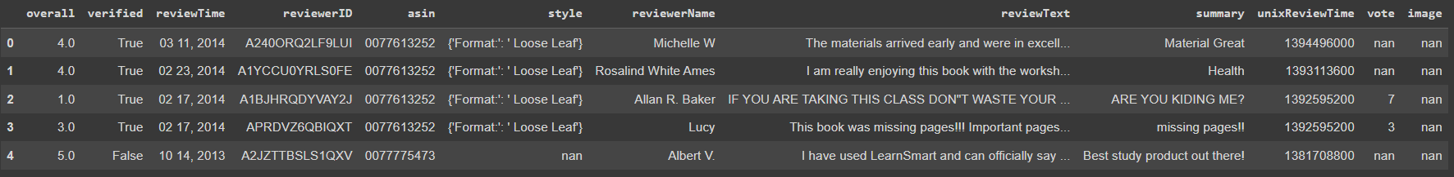
Break Down of Dataset
The columns that were used:
overall - the star rating of the review
reviewText - the actual review
459436 reviews were analyzed

Slide 7
Techniques Used
Preprocessing
To clean the data
To get rid of parts of the dataset we did not need
TF-IDF
To get a term-document matrix we could use for LSA
LSA
To extract semantic meaning from the reviews
Ideally, it will extract the sentiment
K-Means / Clustering
To cluster the LSA features and determine our sentiment groups
PCA
To reduce dimensionality for visualization

Slide 8
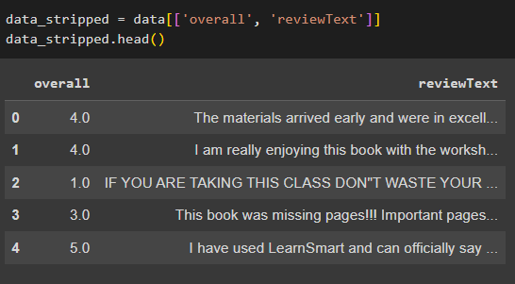
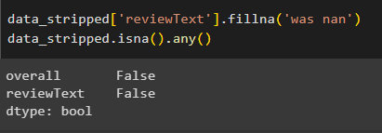
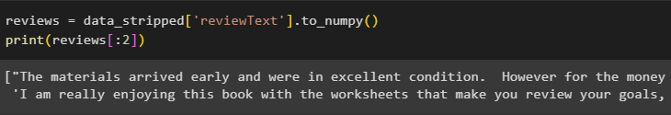
Preprocessing
First, we removed unnecessary columns
Then we removed any NaN values
Finally, we isolated the reviewText column into a numPy array

Slide 9

TF-IDF
LSA requires the TF-IDF matrix
To compute TF-IDF, we used CountVectorizer and TfidfTransformer from scikit-learn:

Slide 10

LSA
We used TruncatedSVD from scikit-learn:
This gave us a 100-dimensional matrix.

Slide 11
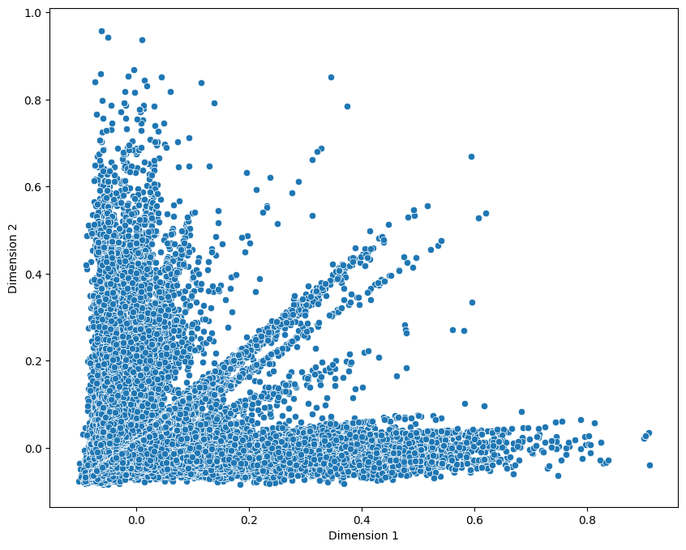

Slide 12

K-Means / Clustering
Using KMeans from scikit-learn, we k-means clustered our LSA features:
We used the resulting clusters to determine our sentiment categories.

Slide 13
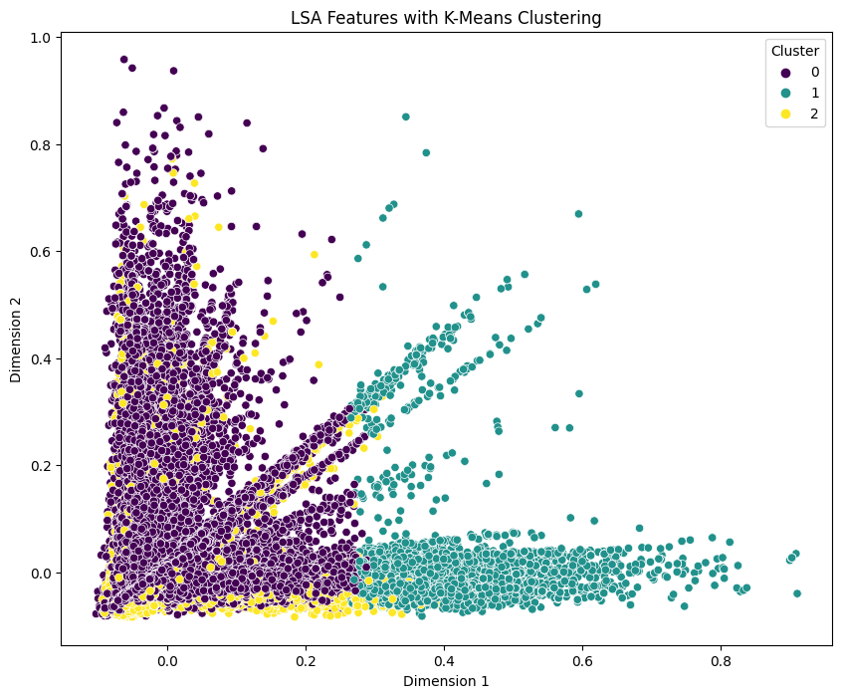

Slide 14
Analysis
Clusters look very odd
Ideally, each one of the “branches” would be a cluster.
Maybe we needed more clusters?
Maybe PCA messes up the results of k-means?
Maybe the number of dimensions we picked for LSA does not fully encapsulate the semantics of the corpus?

Slide 15
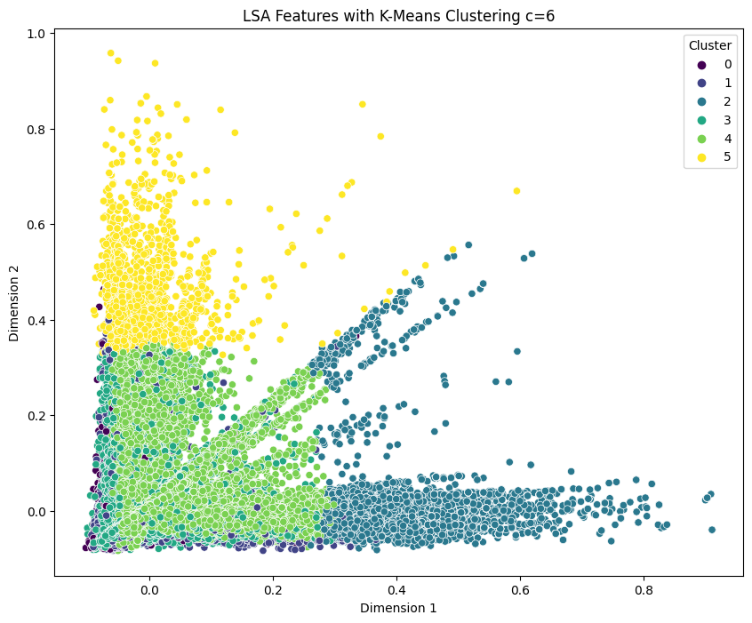

Slide 16
Testing
Given that our goal was to determine sentiment about a product from the review text, our clusters should capture segments of the overall rating
To test this, we graphed the average rating per cluster

Slide 17
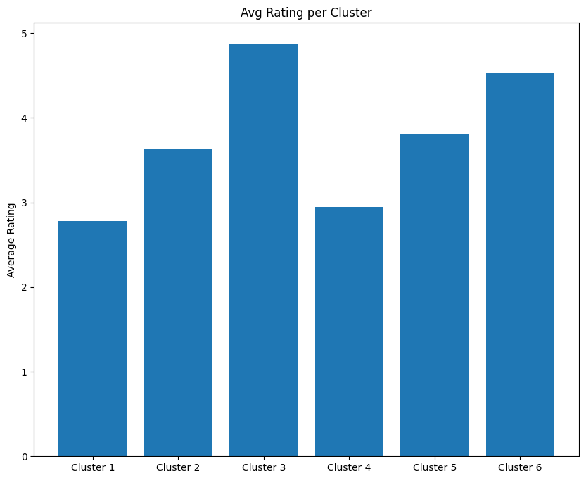

Slide 18
Final Analysis
We can see that, on average, clusters 1 and 4 are medium, 2 and 5 are good, and 3 and 6 are amazing reviews.
This means that our models are extracting some amount of semantic information.
It isn’t perfect, though
Bad reviews are not being isolated into separate clusters
Same for amazing reviews

Slide 19
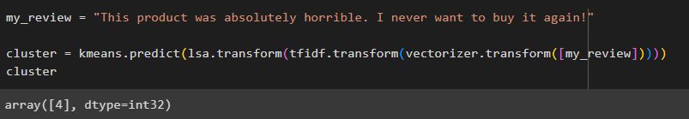
Prediction
Gave it a fake new review
"This product was absolutely horrible. I never want to buy it again!"
It predicted a cluster of 4
This matches the sentiment according to what we graphed earlier!

Slide 20
Final Thoughts
We should try different numbers of dimensions with LSA
100 dimensions might not have been enough to capture all of the semantic information
We should try to optimize the number of clusters
The number of clusters can influence how accurate the clustering is
In the future we can use the LSA features to train our own model
So we can target the sentiment of reviews better
Input is the LSA features, output is the sentiment category

